Slide 1

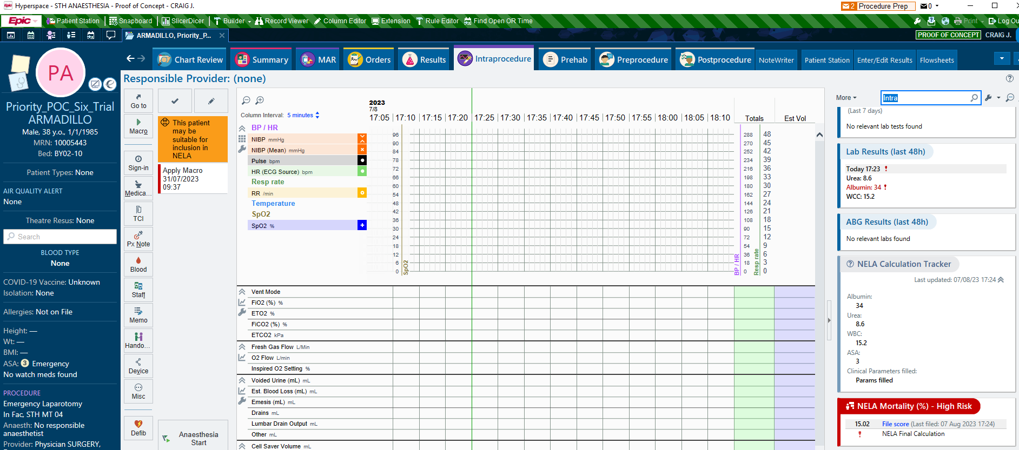
Enhancing Patient Care Through Automated NELA Score Generation from Epic Electronic Health Records
A. Yousaf¹, M. Aftab¹, C. Johnstone², T. Dixson², P. Walsh²
1. King’s College London; 2. Guy’s and St Thomas’ Hospitals, London
Introduction
The Parsimonious NELA Risk Calculator tool provides an estimate of the risk of death within 30 days of emergency abdominal surgery using inserted patient data.¹
The aim of this project was to develop a program which automatically extracts patient data from Epic Electronic Health Records (EHR) to generate a NELA Risk score.
Methods
We developed a programme that uses Epic Electronic Health Record (EHR) to automatically extract relevant data from patients' electronic health records, including their history, clinical findings, and blood results to generate a National Emergency Laparotomy Audit (NELA) Parsimonious score.
To validate the accuracy of the Generated NELA score, we compared our results with those obtained using the NELA score calculator with both normal and extreme values.
Results
The study found that our automated NELA scoring system produced highly accurate results, generating the same estimated morbidity and mortality values as the NELA Calculator regardless of input.
Additionally, the automated system was considerably faster than manual scoring methods, markedly reducing the time required to generate a score.
The data is displayed to the end-user, as shown in Figure 1, to help ensure contemporaneous clinical decision making and correct supervision levels as dictated by the NELA recommendations.
A tracker is also included to display missing parameters if the score cannot be calculated.
Figure 1: A screenshot of the automated programme we developed on Epic EHR, shown on the right sidebar.
Discussion
The development of an automated NELA scoring system using Epic EHR allows for faster identification of higher-risk patients, especially in an urgent/emergent setting.
By accurately and quickly identifying patients at risk for complications, more targeted perioperative interventions can be implemented.
Our study demonstrates the feasibility and effectiveness of using the customisable features available on the Epic’s EHR to extract relevant data and generate NELA scores.
References
https://data.nela.org.uk/riskcalculator/

